Slide 1
18-447 Computer Architecture Recitation 2
Rachata Ausavarungnirun
Carnegie Mellon University
Spring 2015, 2/9/2015

Slide 2
Agenda for Today
Quick recap on the previous lectures
Practice questions
Q&A on HW2, lab3, and lecture materials
Important deadlines:
HW2 due Wednesday (2/11)
Notes:
We start with where we left off last week on ISA tradeoffs and we will finish it today.

Slide 3
Quick Review
Microprogrammed
Microcoded designs
Pipelining
Handling stalls
Data dependences
Data Forwarding
Control Dependences
Fine-grained multithreading
Predicated Execution
Branch Prediction
Notes:
Modern main memory is predominantly built with DRAM cells, which stores data in capacitors

Slide 4
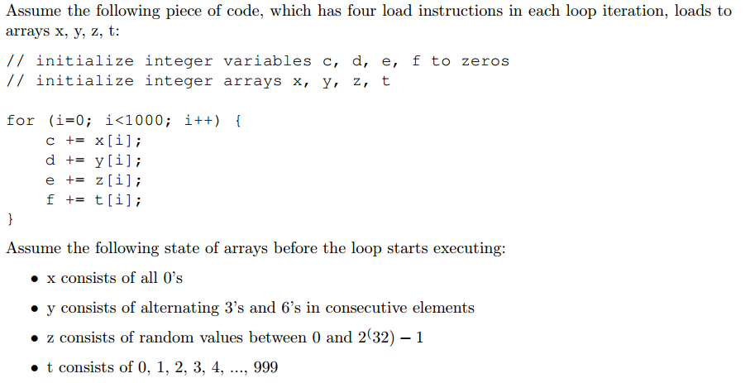
Practice Questions: Value Prediction

Slide 5
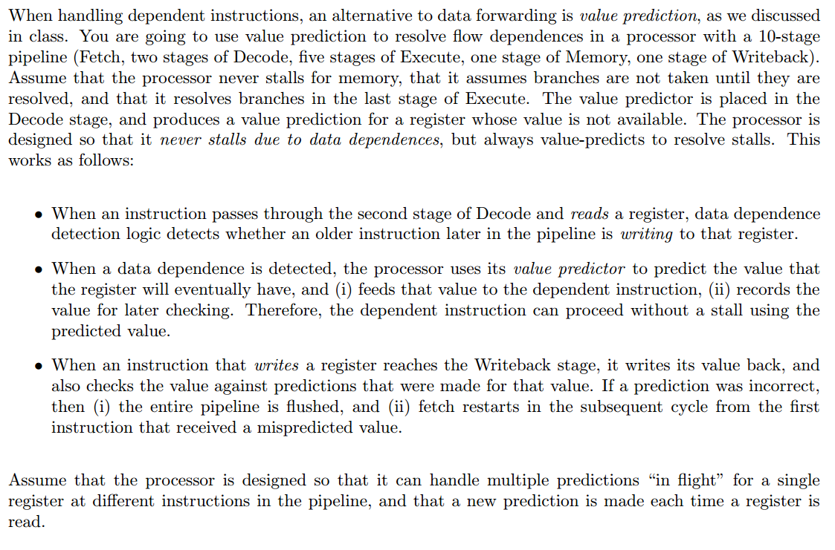
Practice Questions: Pipelining

Slide 6
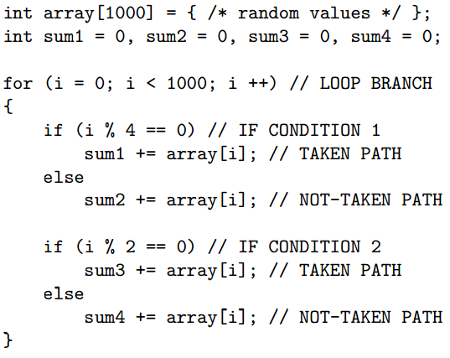
Practice Questions: Branch Prediction

Slide 7
Q & A

